Slide 1


Searching Pulsar candidates with machine learning
James Bielby
Jonathan Fisher
JF

Slide 2

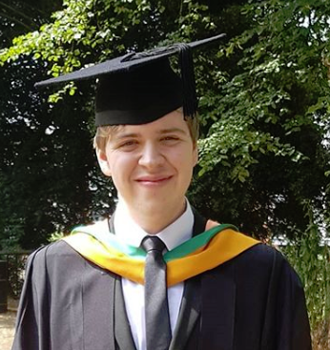
About us
Jon Fisher
Bsc Management and Marketing
UMIST, Manchester
Studying;
Intelligent Systems and Robotics
https://uk.linkedin.com/in/jon-fisher-70b5917
James Bielby
Bsc Intelligent Systems
De Montfort University
Studying;
Intelligent Systems and Robotics
https://dmu.academia.edu/JamesBielby
JF/JB

Slide 3
Aim aND OBJECTIVES
Evaluate different Machine learning techniques for the classification of Pulsar candidates
Problem definition: Which machine learning techniques could be best used to classify pulsar candidates from data produced by the SKA telescopes.
This project seeks to extend the work presented in Fifty Years of Pulsar Candidate Selection: From simple filters to a new principled real-time classification approach R. J. Lyon, B. W. Stappers, S. Cooper, J. M. Brooke, J. D. Knowles, Fifty Years of Pulsar Candidate Selection: From simple filters to a new principled real-time classification approach, Monthly Notices of the Royal Astronomical Society 459 (1), 1104-1123, DOI: 10.1093/mnras/stw656
JF

Slide 4
Ethics
HTRU2 Dataset is freely available and free to use
It is recommended to use the citation given wherever the dataset has been used.
All software has been accessed through appropriate channels. As the project does not provide any financial gain (commercial use), no acknowledgements need to be given.
JB

Slide 5
Project Management
Development areas chosen by the individual, promoting motivation.
Time management; planned with Gantt chart
Collaborative tools; Microsoft teams and Live documents. Whatsapp.
EndNote streamlining references.
JB

Slide 6
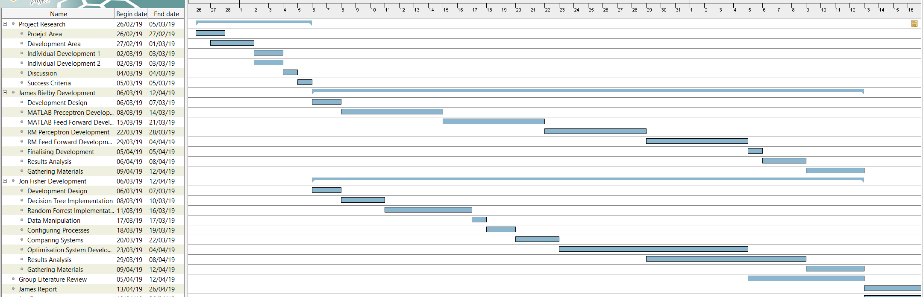

Gantt Chart
JB

Slide 7
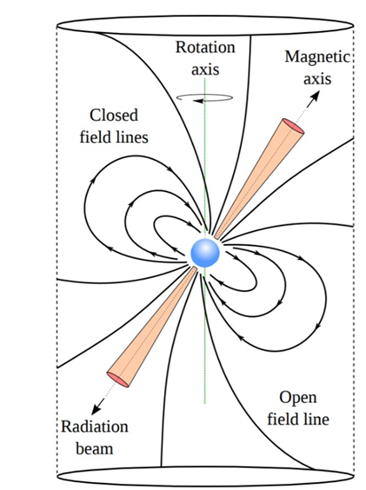
What is a Pulsar?
Neutron Star formed after the collapse of a massive star in a super nova.
One of three possible outcomes. The other 2 are a white dwarf star or a black hole.
Dependant on volume of mass entering the core
Super dense core about 10-15 Km diameter.
Radiation at poles causes it to appear to pulse as it rotates towards and away from the earth.
To –date 2704 have been identified
JF

Slide 8
Just a few of the uses for pulsar data
Calculating the weight of planets
Navigation for spacecraft
Providing directions to earth onboard the voyager satellite missions
Testing our understanding of the universe and Einstein’s Theory of Relativity
Understanding earths ionosphere
Discovery of extrasolar planets
Understanding the galactic magnetic field
Development of pulsar based time scales
The search for dark matter
Gravity waves
Cosmology and origin of the universe
Galactic structure
Probing the Interior of neutron stars
Studies of super-dense matter
Plasma physics under extreme conditions
JF

Slide 9
So why machine learning?
The volume of data is growing rapidly
The SKA telescopes that go live in 2024 are predicted to produce volumes of data in excess of 800 Gigabytes per second.
This data is too large to be stored and batch process so must be analysed realtime
About 20,000 new pulsars are predicted to be found by SKA.
There has been quite a bit of research about turning raw data into potential candidates. Research is now looking at how to classify those candidates.
JF

Slide 10
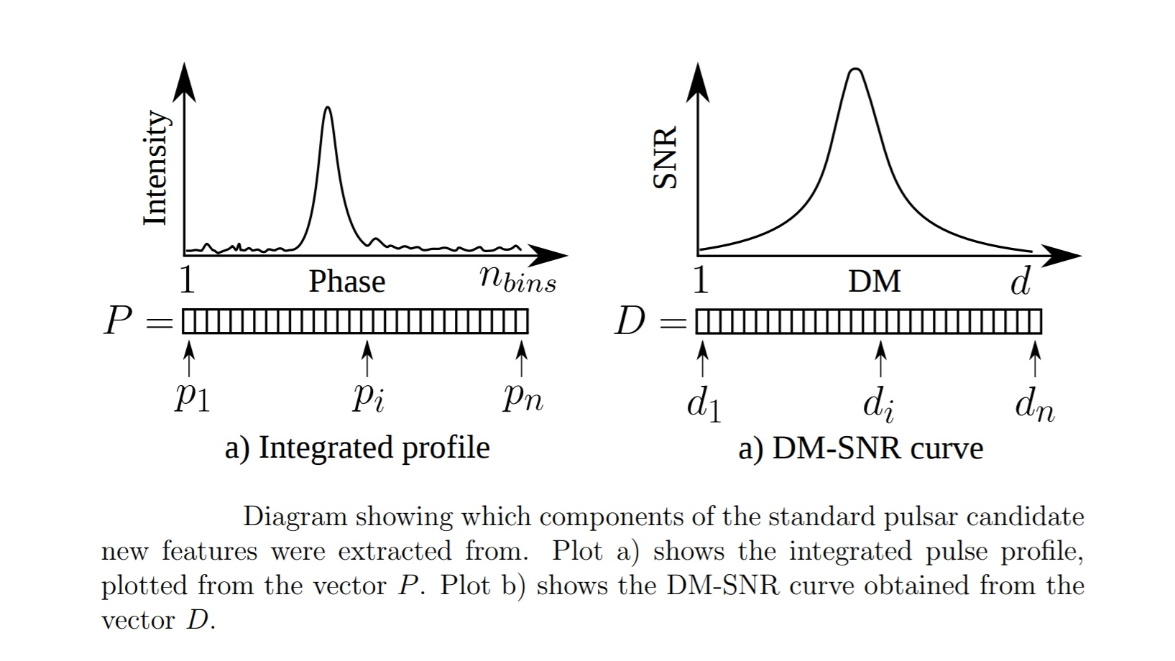
Whats In the dataset?
Integrated profile
Mean
Standard deviation
Excess kurtosis
Skewness
DM-SNR Curve
Mean
Standard deviation
Excess kurtosis
Skewness
17,898 candidates in total of which 1639 are classified as Pulsar
JF

Slide 11
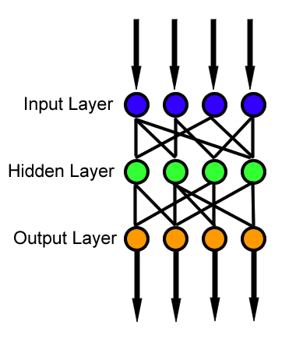
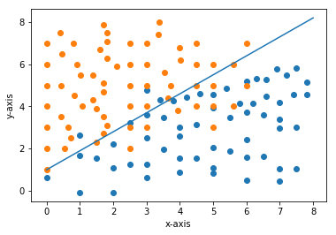
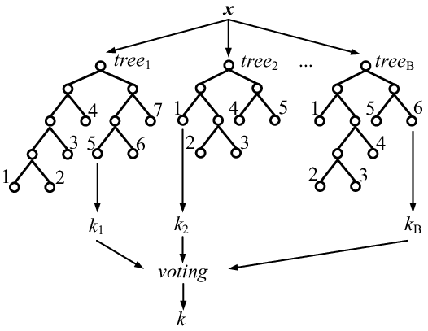
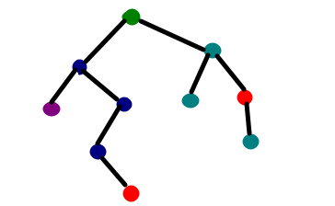
Our ML approaches to HTRU2
Collaboration tools
One Drive
Skype
Microsoft teams
Whatsapp and email
ANN – James Bielby
Matlab
Rapid Miner
Random Forest – J Fisher
Rapid Miner
R
JB

Slide 12
Literature Review and related work
candidate selection
SPIN
PEACE
candidate validation.
“Why Pulsars are hard to find”
Other uses of the dataset
JF

Slide 13
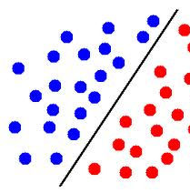
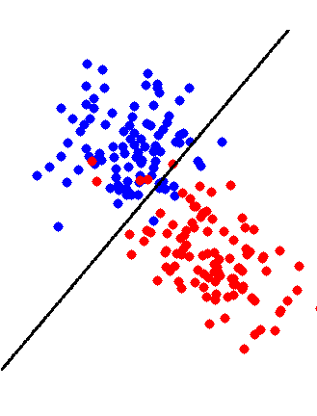
Perceptron Neural Network
Binary Classification only.
Candidate is a pulsar
Candidate is not a pulsar
A Perceptron network projects a hyperplane onto a dataset to find a line of separability.
If a problem is not separable where does this line fit?
Inseparable data can be transformed to a separable problem by the introduction of more data. This will increase the dimensionality of the problem.
JB

Slide 14
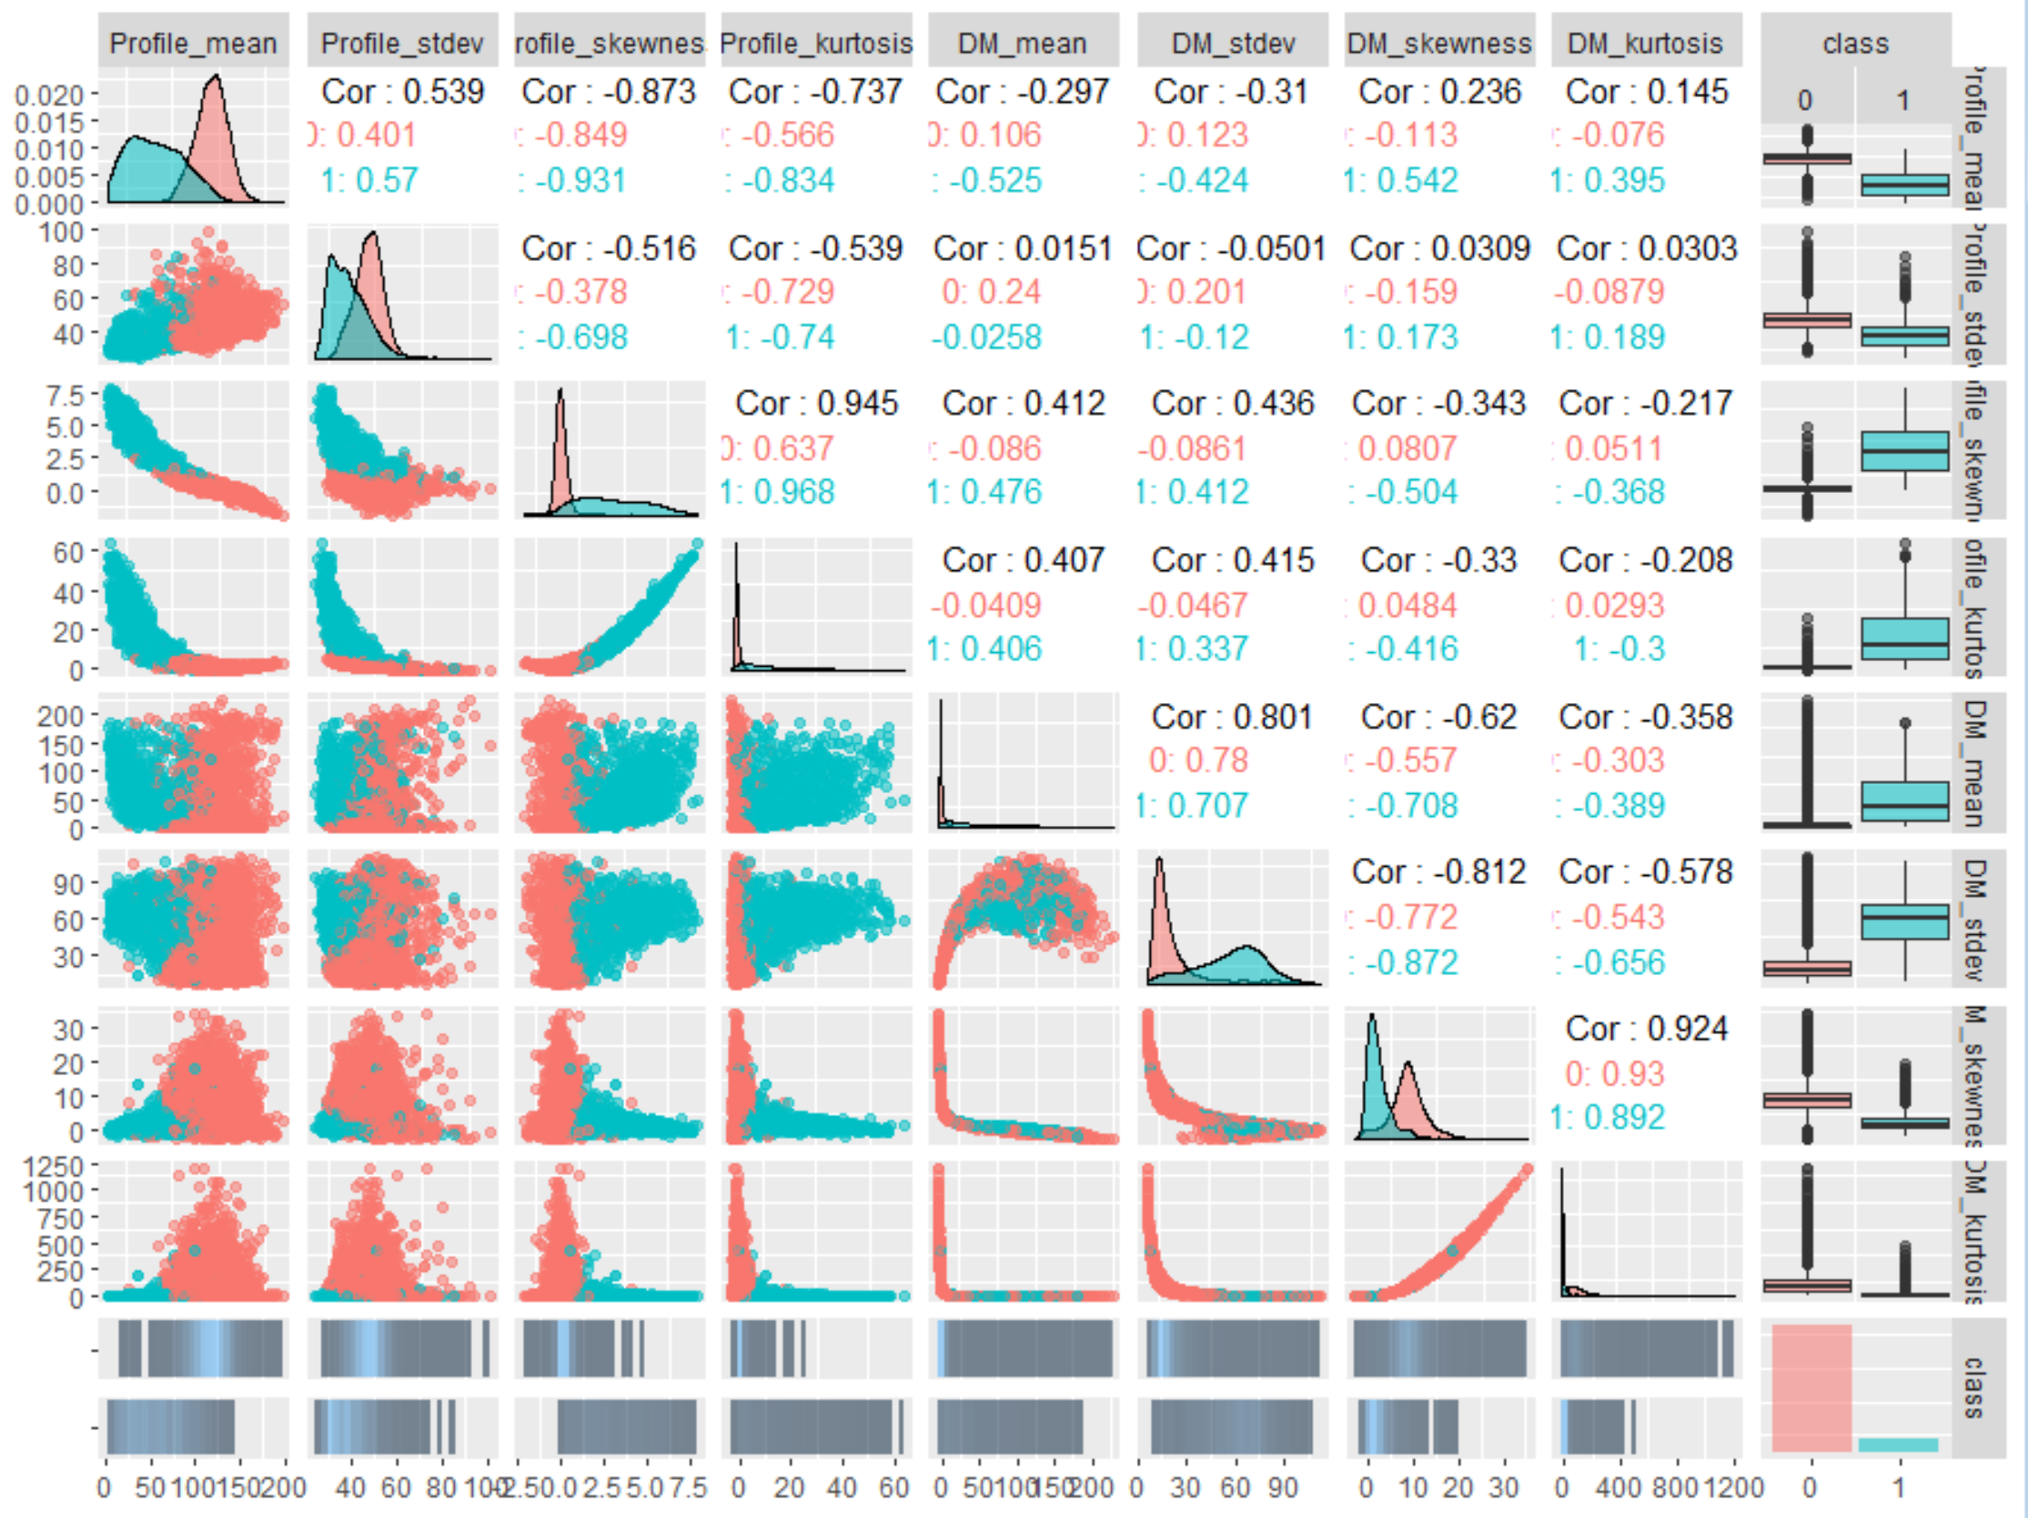
Testing the network
During the development it became clear that some variables showed significantly higher levels of separability over others.
JB

Slide 15

Feed Forward Neural Network
8 input nodes
Data type may implicate the number of hidden neurons.
Each neuron carries an activation
Neurons with specific activation cause patterns to emerge in the hidden layers.
Patterns cause specific outcomes
JB

Slide 16
Topology Comparison
Perceptron
Binary Output
Needs fewer iterations
Iterations take longer to calculate
Output decided by where the data lies relative to the hyperplane
Perceptron’s are more suitable for simple data separation
Feed Forward
No limit to output
More iterations
Iterations take less time
Output decided by the neurons and their specific Activation
FFNN are more suitable for patternicity problems such as image recognition.
JB

Slide 17
Perceptron - Setting up the network
A perceptron network carries very few settings.
Number of iterations
Training and validation split
Data split method
Limited to 10 iterations, after first iteration there is little improvement per additional run.
A perceptron Network will continue to train until the maximum number of iterations has been met or a linearly separable plane has been found.
JB

Slide 18
FFNN - Setting up the network
Limited to 100 iterations, although will often stop once an optimum has been reached
90% of the data holds the classification “0” so the split needs to be a high percentage.
If 60/40 with a random selection all training data could be “0” which will result in no classification of “1”
To set up a FF neural network there are a couple more settings that need defining;
the most important of which is number of hidden layers and number of neurons in these layers.
RULE OF THUMB
The number of neurons per hidden layer must typically lay between the number of inputs (8) and the number of outputs (1)
JB

Slide 19
Performance
Perceptron
96.4633% Correct Classification
62.6% correct classification of “1”
Iterations; 10
Total Time to run; 64.356sec
Avg Time per iteration; 5.8505sec
Feed Forward
98.0389% Correct Classification
84.6% correct classification of “1”
Iterations; 88
Total Time to run; 4.526sec
Avg Time per iteration; 0.0509sec
JB

Slide 20
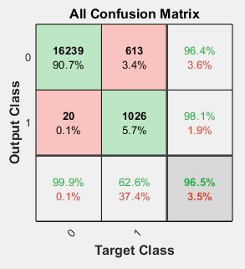
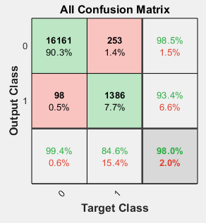
Confusion Matrix
Perceptron
Feed Forward
JB

Slide 21
What do these results mean?
Perceptron's are less accurate for larger datasets (more chance for inseparability)
Perceptron’s take more time per iteration, although they need less iterations to reach their peak accuracy.
Feed Forward Outperformed perceptron's in all but one metric. Time to develop.
The time to develop a competent FF neural network was massively different to the development time of a perceptron network. The perceptron network shown in this assignment took around an hour to create whereas the FF network took days to optimise the settings.
JB

Slide 22
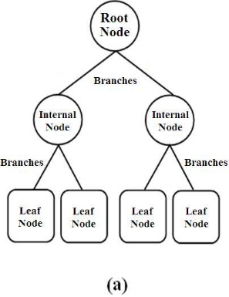
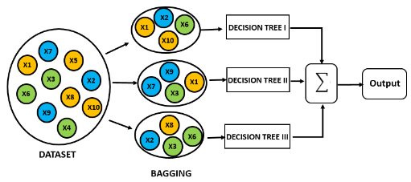
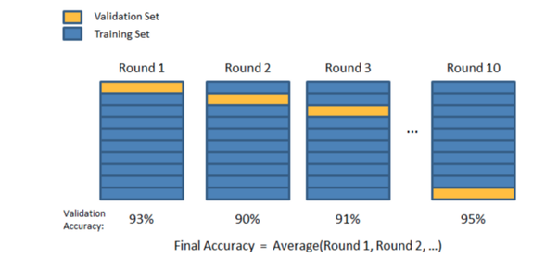
Random Forests (Some terminology)
Tree terminology
Root
Node
Branch
Leaf
Cross Validation
Number of Folds
Out of Bag OOB
JF

Slide 23
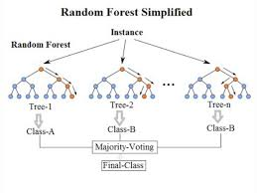
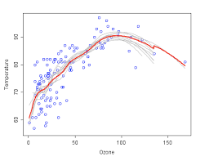
How Random Forests Work
Inherit structure of decision trees
An Ensemble of weak classifiers become a strong classifier
Cross validation with folding becomes part of the structure and is one of the two sources of randomness
The other random variable is the choice of features to be ranked on each branch.
The same features can be represented at on multiple branches on the tree.
JF

Slide 24
Random Forest Methodology
All permutations extrapolated would require 670,644,480 different forests to be evaluated.
15 different experiments incorporating 1244 different random forests to find the best performing random forest.
Grid search across each parameter, combining them when necessary.
Use the best performing settings in subsequent searches
JF

Slide 25
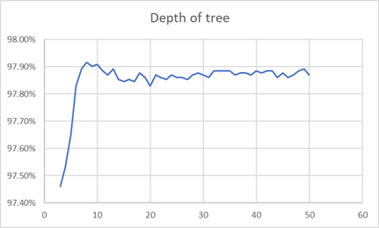
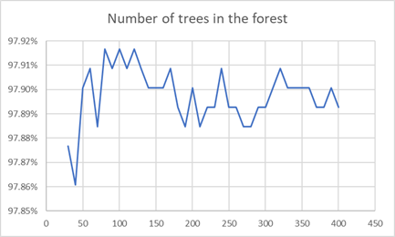
Key parameters – Trees and depth of tree
112 trees
Depth of 8
JF

Slide 26
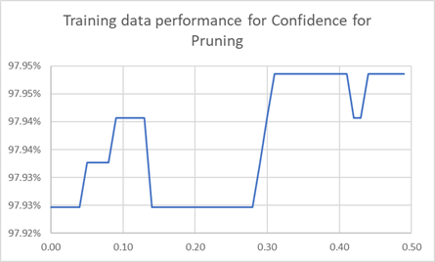
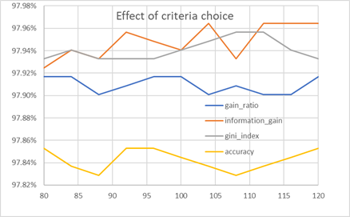
Criteria and Confidence for pruning
0.31 confidence
Information gain or Gini Index over gain ratio
JF

Slide 27
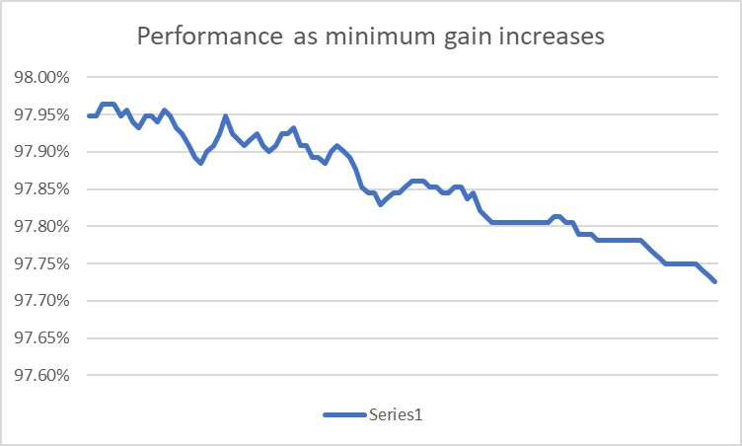
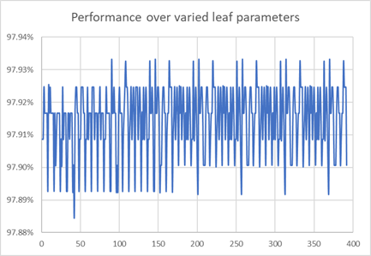
Minimum gain and pre-Pruning parameters
JF

Slide 28
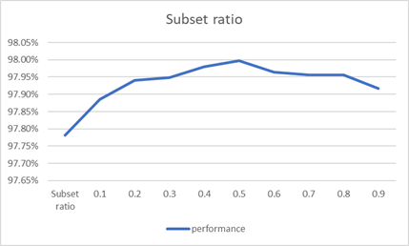
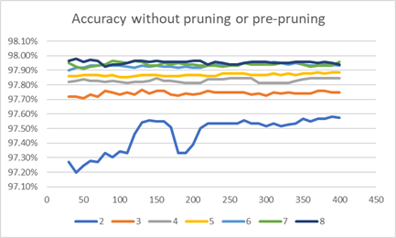
No Pruning and adjusting the Subset ratio
0.5 features perform best against a default of 0.2
No pruning or pre-pruning performs better even with fewer trees (40)
JF

Slide 29
Class Imbalance & Sampling Techniques
Up sampling
Down Sampling
Smote
JF

Slide 30
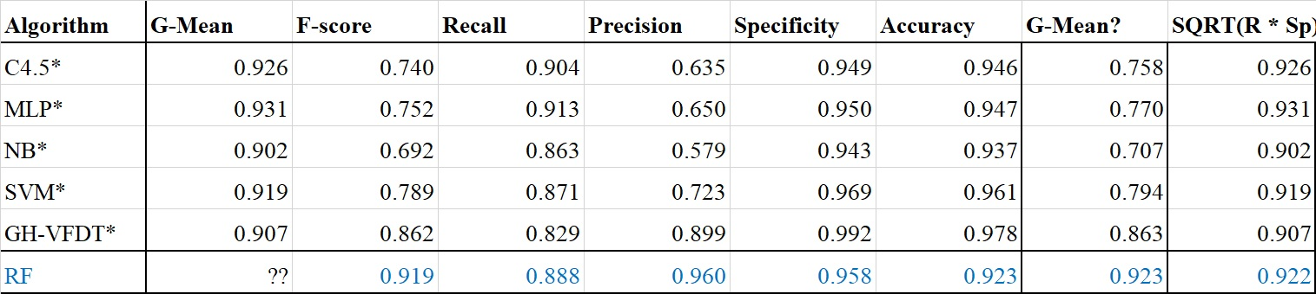
Comparison with Original Paper
JF

Slide 31
conclusions
Both viable
Both highly accurate despite class inbalance
Both improvement over original
Random forest marginally better but very highly tuned
Rapid Miner methodology prone to overtuning
JB/JF

Slide 32
Future work
Investigate how both methodologies can be best applied to streaming data at SKA volumes 800 Gigabytes per second.
Adapt the “Hoeffing anytime tree” to a streaming random forest model and evaluate performance over evolving data.
The neural network could be trained on other datasets.
Modify the Perceptron network to run all permeatations of variables. Currently the network runs as an MLP with all 8 input variables.
JF/JB

Slide 33
Key References
Lyon, R.J., Fifty Years of Candidate Pulsar Selection - What next? 2017.
Lyon, R.J., Why are pulsars hard to find? 2016, The University of Manchester (United Kingdom).
Breiman, L., Random forests. Machine learning, 2001. 45(1): p. 5-32.#
Harris, E. Information Gain Versus Gain Ratio: A Study of Split Method Biases. in ISAIM. 2002.
He, H. and E.A. Garcia, Learning from Imbalanced Data. IEEE Transactions on Knowledge and Data Engineering, 2009. 21(9): p. 1263-1284.

